Slide 1
Wafer Spatial Anlaysis Tool Design Thinking and Implementation
By Adam Yang, Elnatan Mataev, Brian Walsh, Cheng-Yi Lin, Cynthia Manya, Katsunori Onishi, Stephen Wu, Tom Mechler
3/31/2022

Slide 2
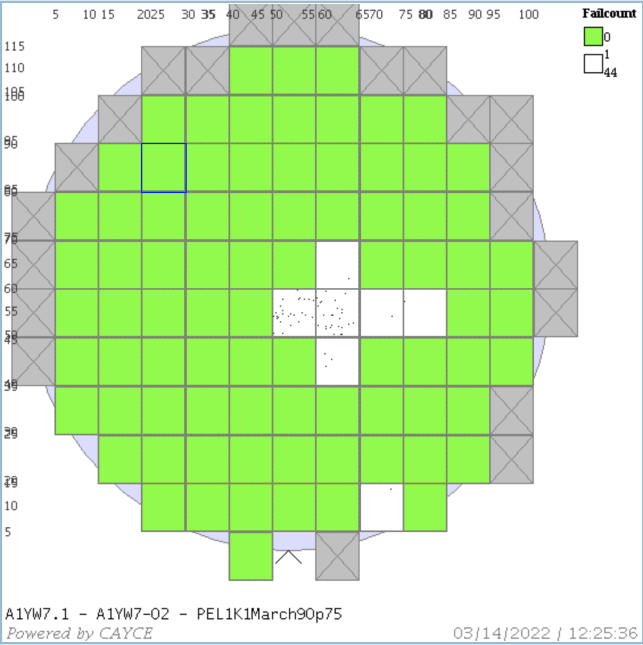
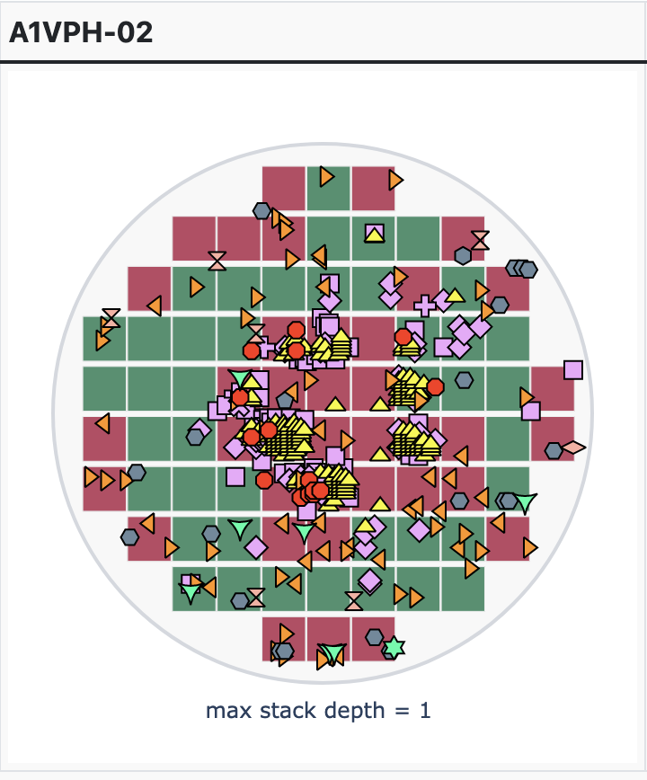
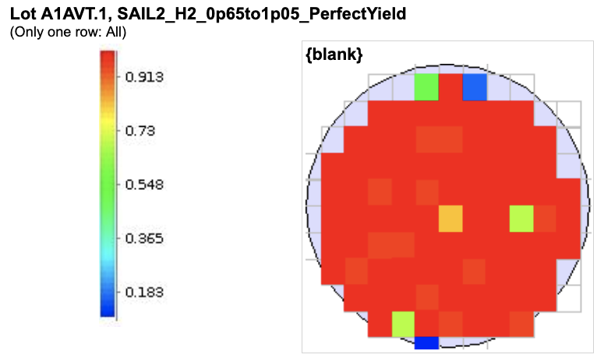
Project Motivation
We have data associated with specific x/y chip coordinates on the wafer.
We want create tools to help engineers take advantage of this wafer regionality data.
We want it to be as versitle as possible (applies to more than just 1 user)
We want it to do something that our current tools can’t easily do

Slide 3
Design Thinking Participants
Leader: Adam Yang
Design-Thinking Coach: Mark Stewart
Participants:
Elnatan Matev
Brian Walsh
Cheng-Yi Lin
Tom Mechler
Cynthia Manya
Stephen Wu
Katsunori Onishi
Plan
Step 1: identify what tool to build
Different problems require different solutions, our first goal is to figure out what problem we want to address first.
Who would use this tool?
What are our pain points?
Can we prioritize these?
Needs Statement Exercise
As-Is Scenario
Step 2: refine the tool
What features would we want on the tool?
What are our needs/wants?
What do we build now, and what do we add later?
How do you visualize yourself using the tool?
Brain Storm Big Ideas Exercise
Prioritzation Excercise

Slide 4
Minimal Viable Product
Tool that accepts input in the form of a csv file, clusters wafer based on defects/yield/measurement regionality and outputs list of wafers associated to each cluster as well as graphical representations of each cluster.
Goals of this tool:
Enable engineers to take advantage of wafer regional data which has been previously under utilized because of how much time/effort it requires.
Be robust and applicable to many forms of data (inline functional, WFT, etc.)
Address the pain points of:
New regional fails are occuring on the wafer, need a way to look back and identify all wafers that might have the same signature
Need a way to cluster wafers with similar fail signatures in order to datamine possible correlations and causations
Need analysis on overall yield detractors, clustering offers a way visualize patterns faster/easier
The MVP can be a stepping stone to other projects that we’ve come up with in our design thinking session.

Slide 5
Requirements to achieving MVP
Write script that enables data input and does exploratory data analysis on the input
This is important because some algorithms like Kmeans clustering is very sensitive to outliers so we have to know if the outliers are real or fake.
Experiment with KMeans clustering algorithm and Convoluted Neural Networks to come up with best solution for clustering problems.
Is scaling required?
What is our performance metric?
If we are using a Kmeans clustering algorithm, we will offer input from user about how many clusters they want.
Also write a script that utilizes the “elbow method” to determine how many clusters are ideal for the inputed data
Need a function to provide graphical outputs too the user to easily visualize the clusters
Stack map of all wafers in each cluster
Individual wafer maps showing each wafer in the cluster
How do we handle this if we have hundreds of wafers?

Slide 6
Future Projects
MVP:
Working spacial clustering tool that accepts csv inputs and outputs wafers in each cluster as well as graphical visuals of each cluster
Extension 1:
Put tool up on dashboard
Extension 2:
Implement way to bypass CSV input and use dropdown to analyze most common parameters
Extension 3:
Capability of tagging your own region of interest and get a list of wafers that are failing in the selected region
Extension 4:
Input a list of wafers failing in the same regionality and get a list of parameters that are also failing in the same region for those wafers

